Slide 1
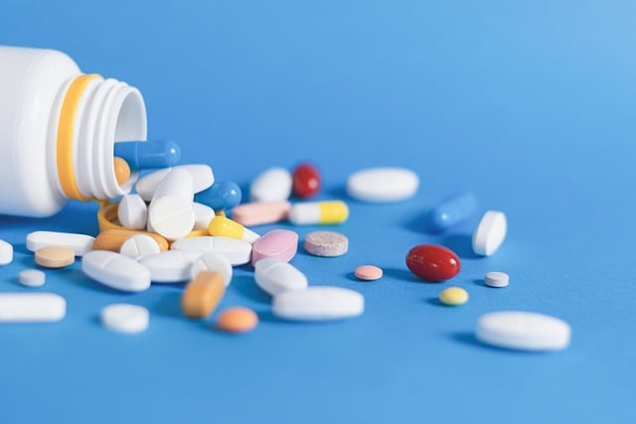
Project Name : Medicine Analysis
Presentation on Report
Prepared by : Yogeshawari Harne
Guid by : Vishal sir

Slide 2
Content
Introduction
Key insights
Conclusion
Recommendation

Slide 3
INTRODUCTION
This dataset contains detailed information on 112,171 medicines, including their price, manufacturer, composition, and whether they are discontinued.
Key columns include the medicine name, price in INR, manufacturer name, and pack size.
It can be used for price analysis, market trends, and discontinuation patterns, providing valuable insights into the pharmaceutical industry.

Slide 4
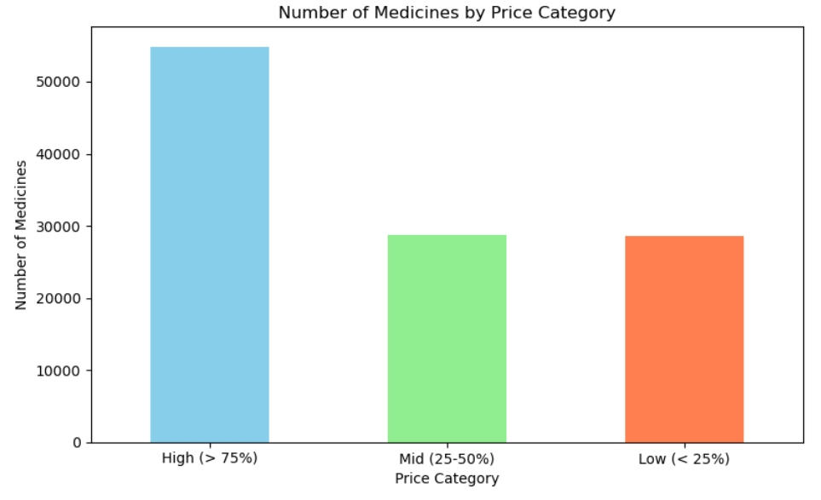
min 1.25000 25% 55.00000 50% 85.00000 75% 140.00000 max 119500.00000
Medicines by price category
Key insights:
High-priced medicines : (above ₹140) dominate the dataset, with over 50,000 medicines.
Mid-priced medicines : (₹55 to ₹85) and
low-priced medicines : (below ₹55) are almost equal in number, each with roughly around 20,000–25,000 medicines.

Slide 5
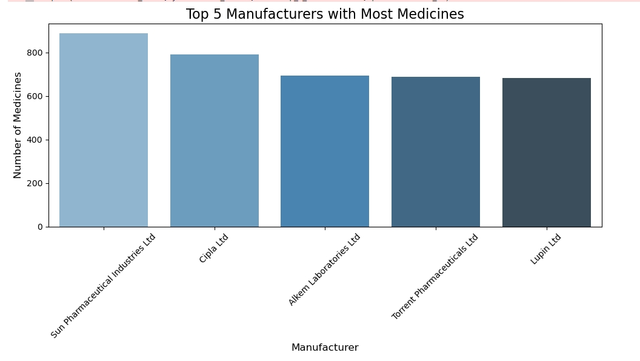
Manufacturers with most medicines
Key insights:
Sun Pharmaceutical Industries Ltd is the leading manufacturer, producing the highest number of medicines, just over 800.
Cipla Ltd follows closely, with around 800 medicines.
Alkem Laboratories Ltd,
Torrent Pharmaceuticals Ltd, and Lupin Ltd have similar counts, all in the range of 600 to 700 medicines.

Slide 6
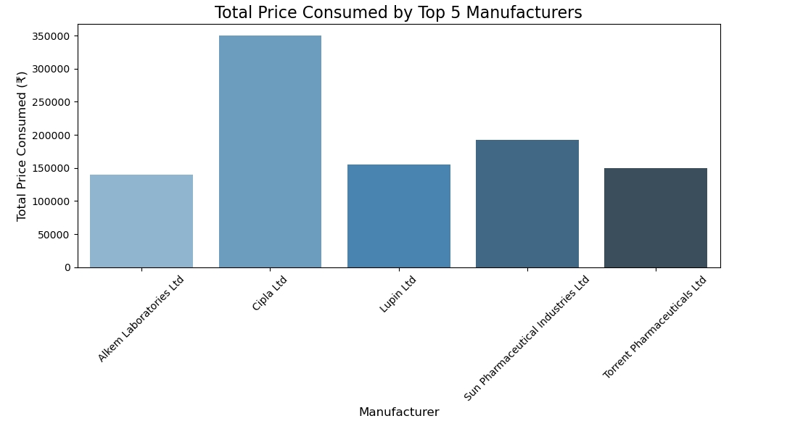
Top 5 Price Manufactures
Key insights
manufacturer_name price(₹) 0
Alkem Laboratories Ltd 140432.21
1 Cipla Ltd 349827.96
2 Lupin Ltd 155236.99
3 Sun Pharmaceutical Industries Ltd 191965.13
4 Torrent Pharmaceuticals Ltd 150113.75

Slide 7
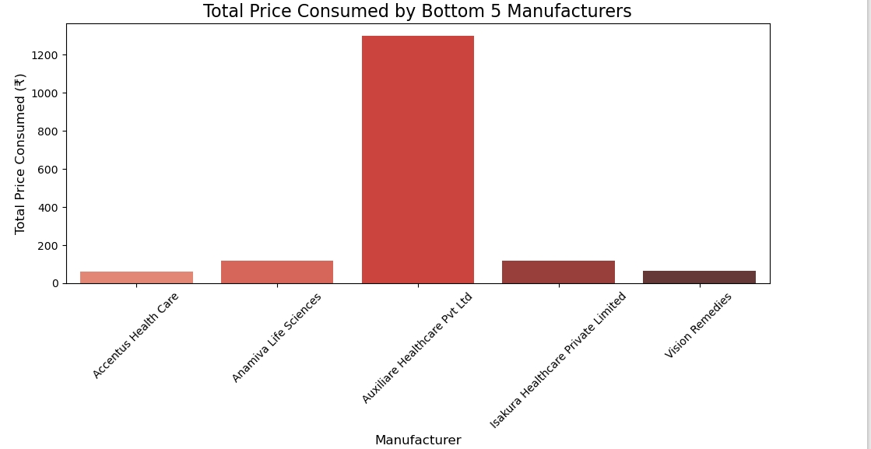
Bottom 5 Price Manufactures
Key insights
manufacturer_name price(₹)
0 Accentus Health Care 60.0
1 Anamiva Life Sciences 120.0
2 Auxiliare Healthcare Pvt Ltd 1299.0
3 Isakura Healthcare Private Limited 120.0
4 Vision Remedies 64.0

Slide 8
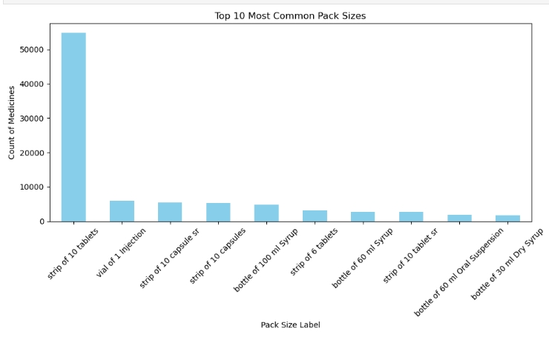
Pack Sizes
Key insights
Strip of 10 tablets is overwhelmingly the most common pack size, with over 50,000 occurrences. This indicates that a large portion of medicines in the dataset are packaged in strips containing 10 tablets.
Other common pack sizes include vials for injection and strips of capsules (both regular and slow-release), though these have significantly fewer occurrences compared to "strip of 10 tablets.“
Liquid formulations like syrups are also common, with pack sizes such as 60 ml and 100 ml bottles appearing in the top 10.

Slide 9
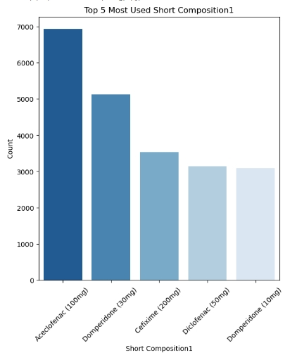
'Top 5 Most Used Short Composition1'
Key insights
Aceclofenac (100mg): Highest usage, with nearly 7,000 occurrences.
Domperidone (30mg): Approximately 5,000 occurrences.
Cefixime (200mg): Around 3,500 occurrences.
Diclofenac (50mg): Around 3,000 occurrences.
Domperidone (10mg): Also around 3,000 occurrences.

Slide 10
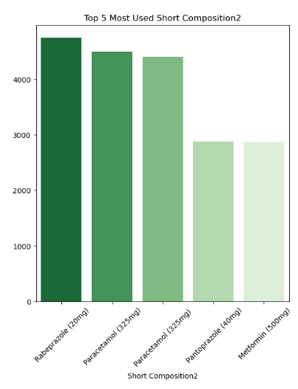
'Top 5 Most Used Short Composition2
Key insights:
Rabeprazole (20mg): Most commonly used in this category, with about 4,500 instances.
Paracetamol (325mg) and Paracetamol (325mg): Both close to 4,000 instances.
Pantoprazole (40mg) and Metformin (500mg): Used around 3,000 times.

Slide 11
CONCLUSION
Price Distribution: The majority of medicines fall within the higher price range (above ₹140), indicating that
premium-priced products dominate the dataset.
Manufacturers: Leading pharmaceutical companies like Sun Pharma and Cipla are major contributors,
producing the highest number of medicines.
Discontinued Medicines: There's a relatively small difference in price between discontinued and non-discontinued
medicines, suggesting price may not be the sole factor in discontinuation decisions.

Slide 12
RECOMMENDATION
Introduce affordable options to cater to price-sensitive customers.
Analyze product discontinuation to prevent with market leaders.
Smaller manufacturers can focus on niche areas to compete with market leaders
Expand mid and low-price products to tap into underserved segments.

